Slide 1

E-COMMERCE: DIGITAL MARKETS, DIGITAL GOODS
Chapter 10
VIDEO CASES
Case 1: M-Commerce: The Past, Present, and Future
Case 2: Ford AutoXchange B2B Marketplace

Slide 2
CHAPTER 10: E-COMMERCE: DIGITAL MARKETS, DIGITAL GOODS
Learning Objectives
What are the unique features of e-commerce, digital markets, and digital goods?
What are the principal e-commerce business and revenue models?
How has e-commerce transformed marketing?
How has e-commerce affected business-to-business transactions?
What is the role of m-commerce in business and what are the most important m-commerce applications?
What issues must be addressed when building an
e-commerce Web site?
© Pearson Education 2012
Notes:
This chapter describes the key features of electronic commerce. Students are participants in e-commerce and they love to talk about their experiences. You can start the conversation by asking if any in the class purchased something today or yesterday online. Draw students out to talk about their good and bad e-commerce experiences. How many have used their cell phones to search for products, or purchase products? How did they use e-commerce in the last holiday season? How has e-commerce changed how they shop and purchase goods and services? How many have used a dating site (don’t expect an honest answer, but some will volunteer).

Slide 3
CHAPTER 10: E-COMMERCE: DIGITAL MARKETS, DIGITAL GOODS
4FOOD: Burgers Go Social
Problem - Differentiate a burger restaurant’s services in crowded marketplace (Manhattan)
Solution – Utilize social networking and crowdsourcing for marketing and services
  Ordering via iPad, online
  Customers can create and name own sandwiches
  Twitter, Facebook, Foursquare integration
Illustrates: Use of information systems to create new products and services
Demonstrates: Use of social networking technologies as marketing tool
© Pearson Education 2012
Notes:
This slide discusses the chapter opening case, which describes the efforts by a new organic burger restaurant in Manhattan to appeal to the social networking audience by integrating services and entertainment with Twitter, Facebook, and Foursquare. Ask students if they have used Foursquare and what their thoughts are about it.

Slide 4
CHAPTER 10: E-COMMERCE: DIGITAL MARKETS, DIGITAL GOODS
E-commerce and the Internet
E-commerce today:
  Use of the Internet and Web to transact business; digitally enabled transactions
  Began in 1995 and grew exponentially, still growing even in a recession
  Companies that survived the dot-com bubble burst and now thrive
  E-commerce revolution is still in its early stages
© Pearson Education 2012
Notes:
This slide discusses what e-commerce is, and what the state of e-commerce is today. The text states that e-commerce history mirrors those of other technology innovations. What other innovations is e-commerce similar to? Students probably will not know about the early days of radio and TV, but perhaps they will remember cassette music, VHS video tapes, and even CDs which though still with us are definitely declining in sales. There are many current trends in e-commerce, from e-books to mobile purchasing. Ask the students to work with you to list some of these new trends in e-commerce.

Slide 5
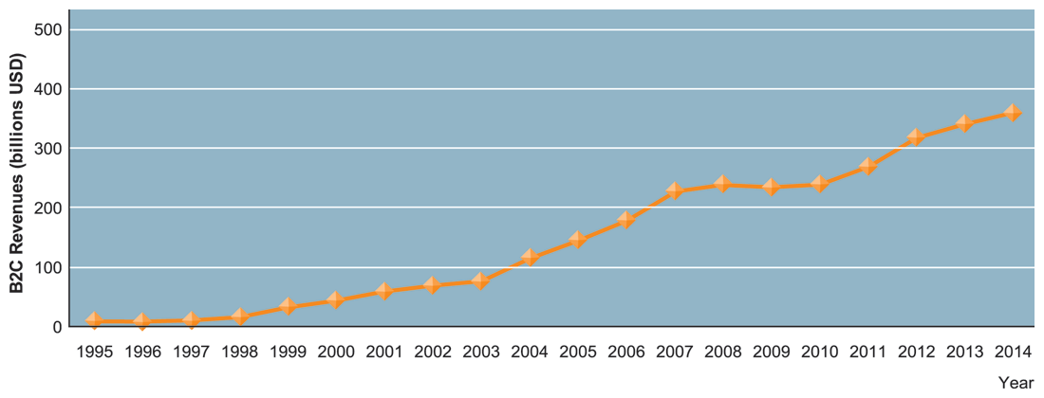
CHAPTER 10: E-COMMERCE: DIGITAL MARKETS, DIGITAL GOODS
E-commerce and the Internet
THE GROWTH OF E-COMMERCE
FIGURE 10-1
Retail e-commerce revenues grew 15–25 percent per year until the recession of 2008–2009, when they slowed measurably. In 2010, e-commerce revenues are growing again at an estimated 12 percent annually.
© Pearson Education 2012
Notes:
This graphic illustrates the continuing growth of e-commerce. From the text: “E-commerce grew at double-digit rates until the recession of 2008–2009 when growth slowed to a crawl. In 2009, e-commerce revenues were flat, not bad considering that traditional retail sales were shrinking by 5 percent annually. In fact, e-commerce during the recession was the only stable segment in retail. Despite the recession, in 2010, the number of online buyers increased by 6 percent to 133 million, and the average annual purchase is up 5 percent to $1,139. Amazon’s sales grew by 28 percent in the year.

Slide 6
CHAPTER 10: E-COMMERCE: DIGITAL MARKETS, DIGITAL GOODS
E-commerce and the Internet
Why e-commerce is different – 8 unique features
  1. Ubiquity
    Internet/Web technology available everywhere: work, home, etc., anytime.
    Effect:
      Marketplace removed from temporal, geographic locations to become “marketspace”
      Enhanced customer convenience and reduced shopping costs
© Pearson Education 2012
Notes:
This slide and the next seven discuss the reasons for the quick growth of e-commerce – namely the unique features of the Internet and e-commerce, which are richer and more powerful than previous technology revolutions like radio and TV. The text describes eight features of the Internet: (1) ubiquity, (2) global reach, (3) universal standards, (4) richness, (5) interactivity, (6) information density, (7) personalization/customization, (8) social technology. Ask students to describe what they think distinguishes the Internet from other communication media or traditional shopping or information experiences.
In terms of commercial benefits, what is special about the quality of “ubiquity”?
The next slide discusses the feature of global reach. Ask students what global reach means and what the effects of global reach are.
(Global reach: Commerce enabled across cultural and national boundaries seamlessly and without modification. Marketspace includes, potentially, billions of consumers and millions of businesses worldwide.)

Slide 7
CHAPTER 10: E-COMMERCE: DIGITAL MARKETS, DIGITAL GOODS
E-commerce and the Internet
8 unique features (cont.)
  Global reach
    The technology reaches across national boundaries, around Earth
    Effect:
      Commerce enabled across cultural and national boundaries seamlessly and without modification
      Marketspace includes, potentially, billions of consumers and millions of businesses worldwide
© Pearson Education 2012
Notes:
This slide discusses the unique feature of global reach. Ask students if they can think of other effects of this quality. Are there social, political, or ethical consequences? Are there any disadvantages?
The next slide discusses the feature of universal standards. Ask students what this means and what its effects might be.
(Universal standards: Disparate computer systems easily communicate with each other. Lower market entry costs—costs merchants must pay to bring goods to market. Lower consumers’ search costs—effort required to find suitable products.)

Slide 8
CHAPTER 10: E-COMMERCE: DIGITAL MARKETS, DIGITAL GOODS
E-commerce and the Internet
8 unique features (cont.)
  Universal standards
    One set of technology standards: Internet standards
    Effect:
      Disparate computer systems easily communicate with each other
      Lower market entry costs—costs merchants must pay to bring goods to market
      Lower consumers’ search costs—effort required to find suitable products
© Pearson Education 2012
Notes:
This slide discusses the unique feature of universal standards. Ask students if they can think of other effects of this quality. Are there social, political, or ethical consequences? Are there any disadvantages?
The next slide discusses the feature of richness. Ask students what this means and what its effects might be.
(Richness: Possible to deliver rich messages with text, audio, and video simultaneously to large numbers of people. Video, audio, and text marketing messages can be integrated into single marketing message and consumer experience.)

Slide 9
CHAPTER 10: E-COMMERCE: DIGITAL MARKETS, DIGITAL GOODS
E-commerce and the Internet
8 unique features (cont.)
  Richness
    Supports video, audio, and text messages
    Effect:
      Possible to deliver rich messages with text, audio, and video simultaneously to large numbers of people
      Video, audio, and text marketing messages can be integrated into single marketing message and consumer experience
© Pearson Education 2012
Notes:
This slide discusses the unique feature of richness. Ask students if they can think of other effects of this quality. Are there social, political, or ethical consequences? Are there any disadvantages?
The next slide discusses the feature of interactivity. Ask students what this means and what its effects might be. (Interactivity: Consumers engaged in dialog that dynamically adjusts experience to the individual. Consumer becomes co-participant in process of delivering goods to market.)

Slide 10
CHAPTER 10: E-COMMERCE: DIGITAL MARKETS, DIGITAL GOODS
E-commerce and the Internet
8 unique features (cont.)
  Interactivity
    The technology works through interaction with the user
    Effect:
      Consumers engaged in dialog that dynamically adjusts experience to the individual
      Consumer becomes co-participant in process of delivering goods to market
© Pearson Education 2012
Notes:
This slide discusses the unique feature of interactivity. Ask students if they can think of other effects of this quality. Are there social, political, or ethical consequences?
The next slide discusses the feature of information density. Ask students what this means and what its effects might be.
(Information density: Greater price transparency. Greater cost transparency. Enables merchants to engage in price discrimination.)

Slide 11
CHAPTER 10: E-COMMERCE: DIGITAL MARKETS, DIGITAL GOODS
E-commerce and the Internet
8 unique features (cont.)
  Information density
    Large increases in information density—the total amount and quality of information available to all market participants
    Effect:
      Greater price transparency
      Greater cost transparency
      Enables merchants to engage in price discrimination
© Pearson Education 2012
Notes:
This slide discusses the unique feature of interactivity. Ask students if they can think of other effects of this quality. Are there social, political, or ethical consequences? Any disadvantages?
The next slide discusses the feature of personalization/customization. Ask students what this means and what its effects might be.
(Personalization/Customization: Personalized messages can be sent to individuals as well as groups. Products and services can be customized to individual preferences.)

Slide 12
CHAPTER 10: E-COMMERCE: DIGITAL MARKETS, DIGITAL GOODS
E-commerce and the Internet
8 unique features (cont.)
  Personalization/Customization
    Technology permits modification of messages, goods
    Effect
      Personalized messages can be sent to individuals as well as groups
      Products and services can be customized to individual preferences
© Pearson Education 2012
Notes:
This slide discusses the unique feature of personalization/customization. Ask students if they can think of other effects of this quality. Are there social, political, or ethical consequences? Any disadvantages? Ask student what the difference is between personalization and customization.
The next slide discusses the feature of social technology. Ask students what this means and what its effects might be.
(Social technology: New Internet social and business models enable user content creation and distribution, and support social networks.)

Slide 13
CHAPTER 10: E-COMMERCE: DIGITAL MARKETS, DIGITAL GOODS
E-commerce and the Internet
8 unique features (cont.)
  Social technology
    The technology promotes user content generation and social networking
    Effect
      New Internet social and business models enable user content creation and distribution, and support social networks
© Pearson Education 2012
Notes:
This slide discusses the eighth unique feature of social technology. Ask students if they can think of other effects of this quality. Are there social, political, or ethical consequences? Any disadvantages?

Slide 14
CHAPTER 10: E-COMMERCE: DIGITAL MARKETS, DIGITAL GOODS
E-commerce and the Internet
Key concepts in e-commerce
  Digital markets reduce
    Information asymmetry
    Search costs
    Transaction costs
    Menu costs
  Digital markets enable
    Price discrimination
    Dynamic pricing
    Disintermediation
© Pearson Education 2012
Notes:
This slide introduces digital markets and discusses the effects of digital markets on the ways companies conduct business. Ask students to define the terms listed here, and also to explain how each of these effects (lowered information asymmetry, etc.) are created by digital markets. Go through each of the three types of costs involving in any marketplace. Students may not be familiar with these words, but they will be familiar with the phenomenon. For instance, all students will recognize that it takes time and money to go to a mall to find a shirt (this is a search cost). The same shirt can be bought on the Web today with minimal search costs.
Information asymmetry: when one party in a transaction has more information that is important for the transaction than the other party
Search costs: The effort to find suitable products
Transaction costs: The cost of participating in a market
Menu costs: Merchants’ costs of changing prices
Price discrimination: Selling the same goods, or nearly the same goods, to different targeted groups at different prices.
Dynamic pricing: The price of a product varies depending on the demand characteristics of the customer or the supply situation of the seller
Disintermediation: The removal of organizations or business process layers responsible for intermediary steps in a value chain

Slide 15
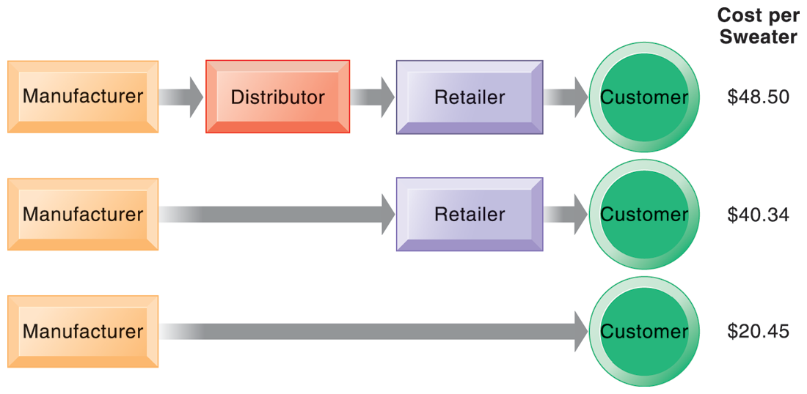
CHAPTER 10: E-COMMERCE: DIGITAL MARKETS, DIGITAL GOODS
E-commerce and the Internet
THE BENEFITS OF DISINTERMEDIATION TO THE CONSUMER
FIGURE 10-2
The typical distribution channel has several intermediary layers, each of which adds to the final cost of a product, such as a sweater. Removing layers lowers the final cost to the consumer.
© Pearson Education 2012
Notes:
This graphic illustrates how disintermediation reduces prices to consumers. It also allows manufacturers to earn more profit for the product by eliminating the middle man. Are middle men really necessary? You should ask students who they think is a “middle man.” Walmart is, for instance, a distributor and retailer. Do they provide an important function? Why can’t manufacturers just ignore Walmart and sell directly to the customer? Even though market disintermediation sounds like a good thing because costs and prices go down, for the most part manufacturers kept their distribution partners and channels. Walmart is still needed by manufacturers like P&G to sell soap.

Slide 16
CHAPTER 10: E-COMMERCE: DIGITAL MARKETS, DIGITAL GOODS
E-commerce and the Internet
Key concepts in e-commerce
  Digital goods
    Goods that can be delivered over a digital network
      E.g. Music tracks, video, software, newspapers, books
    Cost of producing first unit almost entire cost of product: marginal cost of 2nd unit is about zero
    Costs of delivery over the Internet very low
    Marketing costs remain the same; pricing highly variable
    Industries with digital goods are undergoing revolutionary changes (publishers, record labels, etc.)
© Pearson Education 2012
Notes:
This slide continues the discussion of key concepts in e-commerce, looking at digital goods and how these compare with traditional goods.
Ask students how their purchases of digital goods have changed over the past five years. Are digital goods equal in value to their traditional counterparts? What benefits and drawbacks do they have? Music, for instance, used to be a physical product (record or CD) not a digital product or digital service.

Slide 17
CHAPTER 10: E-COMMERCE: DIGITAL MARKETS, DIGITAL GOODS
E-commerce: Business and Technology
Types of e-commerce
  Business-to-consumer (B2C)
  Business-to-business (B2B)
  Consumer-to-consumer (C2C)
  Mobile commerce (m-commerce)
© Pearson Education 2012
Notes:
This slide introduces the types of e-commerce. B2C, B2B, and C2C e-commerce are categorized according to the nature of the participants. M-commerce is a category based on the nature of the connection to the Internet. Ask students to provide examples of the different types of e-commerce listed here. Most students will find it hard to come up with a B2B example. One place you can visit on the Web is grainger.com, one of the largest B2B marketplaces in the U.S. Another is mcmaster.com, and also elemica.com (chemical industry).

Slide 18
CHAPTER 10: E-COMMERCE: DIGITAL MARKETS, DIGITAL GOODS
E-commerce: Business and Technology
E-commerce business models
  Portal
  E-tailer
  Content Provider
  Transaction Broker
  Market Creator
  Service Provider
  Community Provider
© Pearson Education 2012
Notes:
This slide continues the discussion of new Internet business models. Ask students to give examples of these business models. For each model, ask students about their experience, or ask for examples for each model. Ask how these business models create revenue. For instance,
Content provider – Revenue: Access fees, advertising
Portal – Revenue: Advertising
Service provider – Revenue: Subscription fees, advertising
While many of the new business models are pure-play, some, especially in the retail industry, are clicks-and-mortar.
Some of the new models take advantage of the Internet’s communication capabilities, such as the social networking sites.

Slide 19
CHAPTER 10: E-COMMERCE: DIGITAL MARKETS, DIGITAL GOODS
E-commerce: Business and Technology
LOCATION-BASED MARKETING AND ADVERTISING
Based on your reading in this chapter, how would you characterize O2’s business model?
If O2 is to have a revenue model, which of the revenue models described in this chapter would work?
What considerations do O2 need to make when targeting potential customers?
What other types of businesses might benefit from this type of location-based marketing?
© Pearson Education 2012
Notes:
This slide presents discussion questions regarding the case study of O2, a UK-based mobile carrier who launched the UK’s first location-based marketing service targeting mobile devices. How many students have experienced this type of advertising? What are the benefits/problems of this type of marketing?

Slide 20
CHAPTER 10: E-COMMERCE: DIGITAL MARKETS, DIGITAL GOODS
E-commerce: Business and Technology
E-commerce revenue models
  Advertising
  Sales
  Subscription
  Free/Freemium
  Transaction Fee
  Affiliate
© Pearson Education 2012
Notes:
This slide discusses the ways in which e-commerce sites make money – their revenue model. Ask students to give examples of sites for each type of revenue model.
Advertising – Yahoo
Sales – Amazon
Subscription – Wall Street Journal
Free/freemium – Flckrs
Transaction fee – eTrade
Affiliate – Amazon, MyPoints

Slide 21
CHAPTER 10: E-COMMERCE: DIGITAL MARKETS, DIGITAL GOODS
E-commerce: Business and Technology
Most popular Web 2.0 service: social networking
  Social networking sites sell banner ads, user preference information, and music, videos and e-books
Social shopping sites
  Swap shopping ideas with friends (Kaboodle, ThisNext)
Wisdom of crowds/crowdsourcing
  Large numbers of people can make better decisions about topics and products than a single person
Prediction markets:
  Peer-to-peer betting markets on specific outcomes (elections, sales figures, designs for new products)
© Pearson Education 2012
Notes:
This slide discusses the impact of the social networking aspect of Web 2.0 technologies. Most students will be well aware of social networking technologies, but have they heard of prediction markets? Ask them to investigate this further on their own time. How can these techniques and phenomenon be used by business firms? LinkedIn is the largest professional and business social network that members often use to recruit employees and find jobs.

Slide 22
CHAPTER 10: E-COMMERCE: DIGITAL MARKETS, DIGITAL GOODS
E-commerce: Business and Technology
FACEBOOK: MANAGING YOUR PRIVACY FOR THEIR PROFIT
What concepts in the chapter are illustrated in this case?
Describe the weaknesses of Facebook’s privacy policies and features. What management, organization, and technology factors have contributed to those weaknesses?
List and describe some of the options that Facebook managers have in balancing privacy and profitability. How can Facebook better safeguard user privacy? What would be the impact on its profitability and business model?
Do you anticipate that Facebook will be successful in developing a business model that monetizes their site traffic? Why or why not?
© Pearson Education 2012
Notes:
This slide presents discussion questions regarding the case study of Facebook, the largest social networking site in the world. Facebook uses the advertising revenue models and advertisers using Facebook are interested in targeting audiences based on personal information posted by users to Facebook, many of whom wish to keep their personal information private.

Slide 23
CHAPTER 10: E-COMMERCE: DIGITAL MARKETS, DIGITAL GOODS
E-commerce: Business and Technology
E-commerce marketing
  Internet provides marketers with new ways of identifying and communicating with customers
  Long tail marketing: Ability to reach a large audience inexpensively
  Behavioral targeting: Tracking online behavior of individuals on thousands of Web sites
  Advertising formats include search engine marketing, display ads, rich media, and e-mail
© Pearson Education 2012
Notes:
Ask students to explain why marketers are looking to analyze blog content, and content from chat rooms and message boards. Have students describe and evaluate their experiences with advertising on social networks, via e-mail, and other online formats.

Slide 24
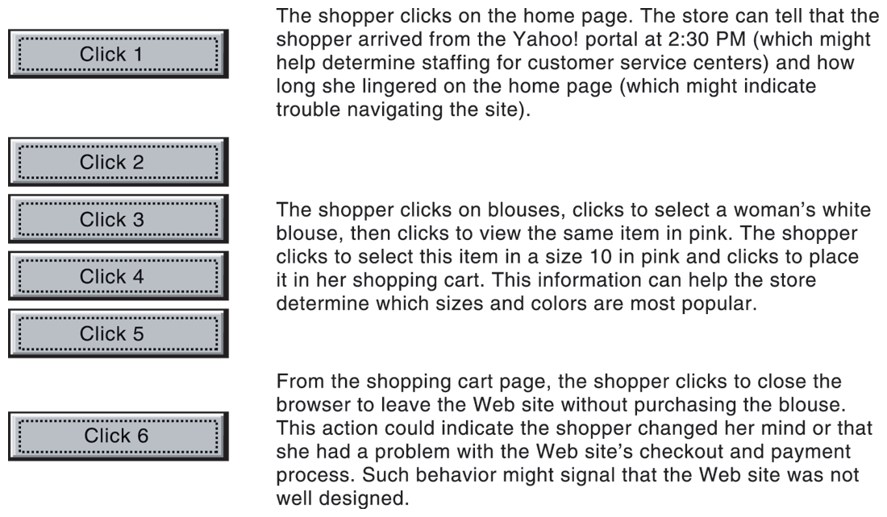
CHAPTER 10: E-COMMERCE: DIGITAL MARKETS, DIGITAL GOODS
E-commerce: Business and Technology
WEB SITE VISITOR TRACKING
FIGURE 10-3
E-commerce Web sites have tools to track a shopper’s every step through an online store. Close examination of customer behavior at a Web site selling women’s clothing shows what the store might learn at each step and what actions it could take to increase sales.
© Pearson Education 2012
Notes:
This graphic illustrates how clickstream tracking works and what the store can tell about the activities of a shopper on their Web site. Extensive metrics exist for various types of user behavior, from the time spent on a Web page to the number of products ordered and placed in a shopping cart but not purchased.

Slide 25
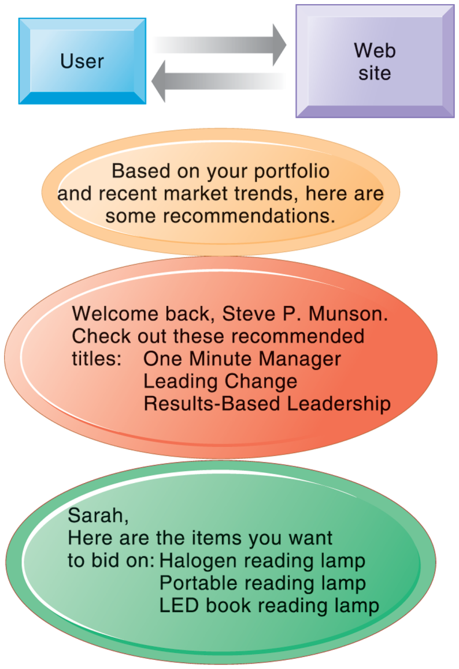
CHAPTER 10: E-COMMERCE: DIGITAL MARKETS, DIGITAL GOODS
E-commerce: Business and Technology
WEB SITE PERSONALIZATION
Firms can create unique personalized Web pages that display content or ads for products or services of special interest to individual users, improving the customer experience and creating additional value.
FIGURE 10-4
© Pearson Education 2012
Notes:
This graphic illustrates some of the types of personalization that clickstream tracking can make possible. Have students found suggestions made by a Web site useful in their experience? You can go to Amazon.com and illustrate how recommender systems work. Search for a product, and then scroll to the bottom of the page where Amazon’s recommender will tell you what other people who looked at the current page actually bought. Netflix is also an excellent site to demonstrate personalization.

Slide 26
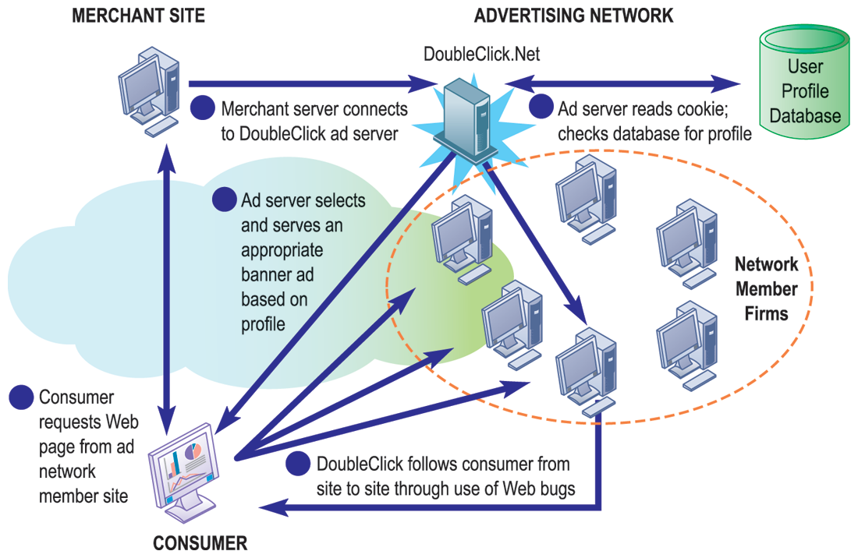
CHAPTER 10: E-COMMERCE: DIGITAL MARKETS, DIGITAL GOODS
E-commerce: Business and Technology
HOW AN ADVERTISING NETWORK SUCH AS DOUBLECLICK WORKS
Advertising networks have become controversial among privacy advocates because of their ability to track individual consumers across the Internet.
FIGURE 10-5
© Pearson Education 2012
Notes:
What do students think (or do they think) about how advertising networks follow them around the Internet? It’s actually quite difficult for anyone to know when they are being tracked by a network, and even more difficult to find out how the information is being used. What social benefits are provided by social networks and ad targeting?

Slide 27
CHAPTER 10: E-COMMERCE: DIGITAL MARKETS, DIGITAL GOODS
E-commerce: Business and Technology
Business-to-business e-commerce
  Electronic data interchange (EDI)
    Computer-to-computer exchange of standard transactions such as invoices, purchase orders
    Major industries have EDI standards that define structure and information fields of electronic documents for that industry
    More companies increasingly moving away from private networks to Internet for linking to other firms
      E.g. Procurement: Businesses can now use Internet to locate most low-cost supplier, search online catalogs of supplier products, negotiate with suppliers, place orders, etc.
© Pearson Education 2012
Notes:
This slide looks at changes brought to B2B e-commerce by Internet technologies. Note that the Internet and Web technology enable businesses to create new electronic storefronts for selling to other businesses with multimedia graphic displays and interactive features similar to those for B2C commerce. Alternatively, businesses can use Internet technology to create extranets or electronic marketplaces for linking to other businesses for purchase and sale transactions.

Slide 28
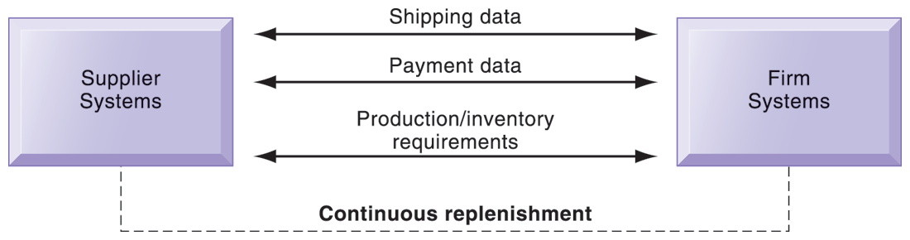
CHAPTER 10: E-COMMERCE: DIGITAL MARKETS, DIGITAL GOODS
E-commerce: Business and Technology
ELECTRONIC DATA INTERCHANGE (EDI)
FIGURE 10-6
Companies use EDI to automate transactions for B2B e-commerce and continuous inventory replenishment. Suppliers can automatically send data about shipments to purchasing firms. The purchasing firms can use EDI to provide production and inventory requirements and payment data to suppliers.
© Pearson Education 2012
Notes:
This graphic illustrates how EDI is used by firms and their suppliers to automate transactions for both B2B e-commerce and continuous replenishment. EDI is still widely used but it has limitations outlined in the book and is not designed for supporting marketplace operations where you have hundreds of vendors and buyers.

Slide 29
CHAPTER 10: E-COMMERCE: DIGITAL MARKETS, DIGITAL GOODS
E-commerce: Business and Technology
Business-to-business e-commerce (cont.)
  Private industrial networks (private exchanges)
    Large firm using extranet to link to its suppliers, distributors and other key business partners
    Owned by buyer
    Permits sharing of:
      Product design and development
      Marketing
      Production scheduling and inventory management
      Unstructured communication (graphics and e-mail)
© Pearson Education 2012
Notes:
This slide continues the discussion of ways the Internet and Web technologies have changed B2B e-commerce. One way is in using an extranet to link to the firm’s suppliers. The text provides the example of VW Group Supply, which links the Volkswagen Group and its suppliers. VW Group Supply handles 90 percent of all global purchasing for Volkswagen, including all automotive and parts components.

Slide 30
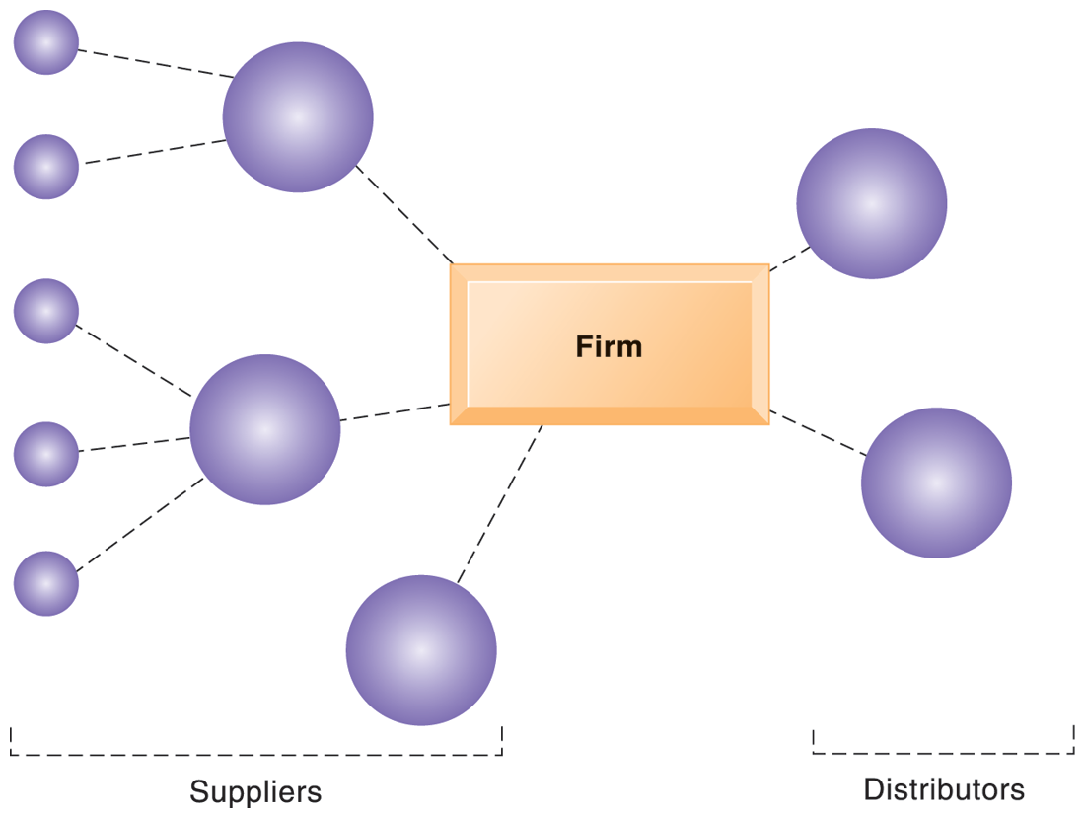
CHAPTER 10: E-COMMERCE: DIGITAL MARKETS, DIGITAL GOODS
E-commerce: Business and Technology
A PRIVATE INDUSTRIAL NETWORK
A private industrial network, also known as a private exchange, links a firm to its suppliers, distributors, and other key business partners for efficient supply chain management and other collaborative commerce activities.
FIGURE 10-7
© Pearson Education 2012
Notes:
This graphic illustrates a private industrial network, and how it can link to both suppliers and distributors. Private industrial networks are owned by the company that uses and creates them. They are “private” and you need to be asked to join.

Slide 31
CHAPTER 10: E-COMMERCE: DIGITAL MARKETS, DIGITAL GOODS
E-commerce: Business and Technology
Business-to-business e-commerce (cont.)
  Net marketplaces (e-hubs)
    Single market for many buyers and sellers
    Industry-owned or owned by independent intermediary
    Generate revenue from transaction fees, other services
    Use prices established through negotiation, auction, RFQs, or fixed prices
    May focus on direct or indirect goods
    May be vertical or horizontal marketplaces
© Pearson Education 2012
Notes:
This slide continues the discussion of ways the Internet and Web technologies have changed B2B e-commerce, in this case by the ability to create Net marketplaces. Ask students to distinguish between and provide examples of direct and indirect goods. (Direct goods are goods used in a production process, such as sheet steel for auto body production. Indirect goods are all other goods not directly involved in the production process, such as office supplies or products for maintenance and repair.)
Ask students to distinguish between vertical and horizontal marketplaces.

Slide 32
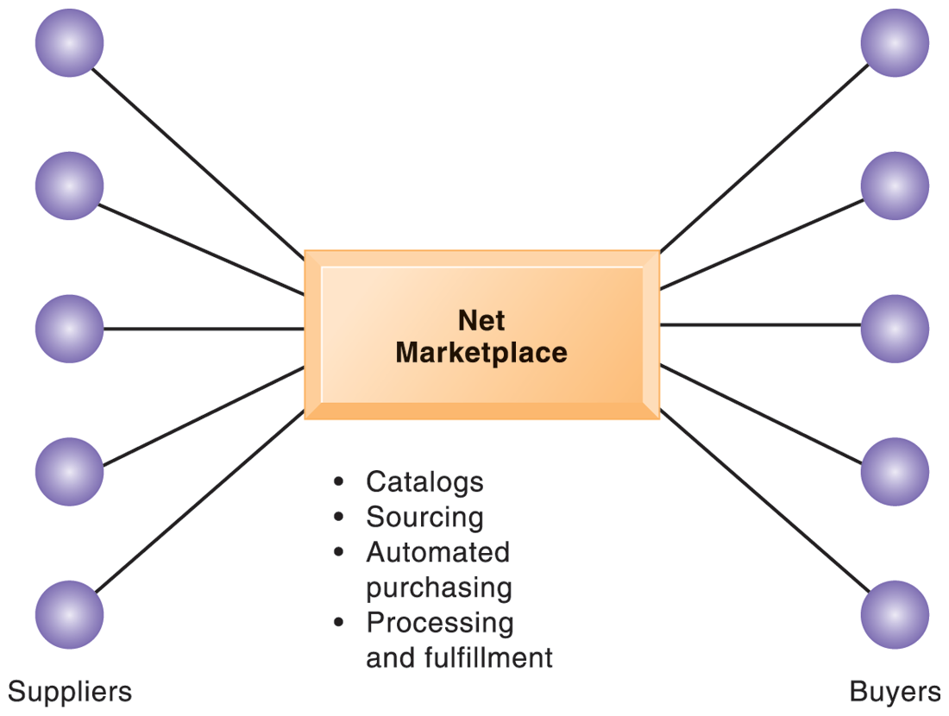
CHAPTER 10: E-COMMERCE: DIGITAL MARKETS, DIGITAL GOODS
E-commerce: Business and Technology
A NET MARKETPLACE
Net marketplaces are online marketplaces where multiple buyers can purchase from multiple sellers.
FIGURE 10-8
© Pearson Education 2012
Notes:
This graphic illustrates a net marketplace, and the functions that it can provide to participants in managing their transactions. The text provides the example of Exostar, an aerospace and defense industry-sponsored Net marketplace that focuses on long-term contract purchasing relationships and on providing common networks and computing platforms for reducing supply chain inefficiencies. More than 16,000 trading partners in the commercial, military, and government sectors use Exostar’s sourcing, e-procurement, and collaboration tools for both direct and indirect goods.

Slide 33
CHAPTER 10: E-COMMERCE: DIGITAL MARKETS, DIGITAL GOODS
E-commerce: Business and Technology
Business-to-business e-commerce (cont.)
  Exchanges
    Independently owned third-party Net marketplaces
    Connect thousands of suppliers and buyers for spot purchasing
    Typically provide vertical markets for direct goods for single industry (food, electronics)
    Proliferated during early years of e-commerce; many have failed
      Competitive bidding drove prices down and did not offer long-term relationships with buyers or services to make lowering prices worthwhile
© Pearson Education 2012
Notes:
This slide continues the discussion of ways the Internet and Web technologies have changed B2B e-commerce, in this case by the ability to create exchanges. The text provides the example of FoodTrader.com, which automates spot purchases among buyers and sellers from more than 180 countries in the food and agriculture industry.

Slide 34
CHAPTER 10: E-COMMERCE: DIGITAL MARKETS, DIGITAL GOODS
The Mobile Digital Platform and Mobile E-commerce
M-commerce
  Although m-commerce represents small fraction of total e-commerce transactions, revenue has been steadily growing
    Location-based services
    Banking and financial services
    Wireless advertising and retailing
    Games and entertainment
© Pearson Education 2012
Notes:
This slide introduces m-commerce, the use of wireless mobile devices for purchasing goods and services. M-commerce is especially well-suited for location-based applications and services. Ask students what applications and services they use with their cell-phones. Have any purchased games or entertainment, and from what companies? Have used a location-based service? A neat site to visit is http://www.wikitude.org/ and explore Wikitude.me, a geo-tagging service.

Slide 35
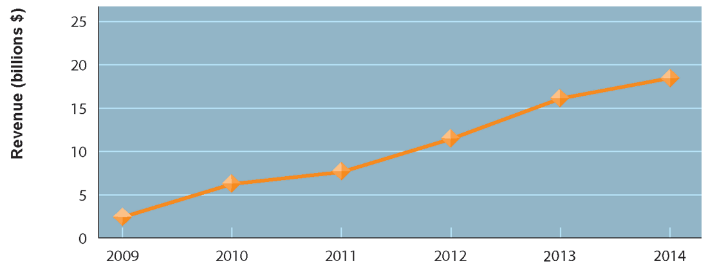
CHAPTER 10: E-COMMERCE: DIGITAL MARKETS, DIGITAL GOODS
The Mobile Digital Platform and Mobile E-commerce
CONSOLIDATED MOBILE COMMERCE REVENUES
FIGURE 10-9
Mobile e-commerce is the fastest growing type of B2C e-commerce although it represents only a small
part of all e-commerce in 2010.
© Pearson Education 2012
Notes:
This graph illustrates the surging growth of m-commerce sales. In the early years prior to 2009, m-commerce in the US was very small and not growing rapidly. Cell phones, especially smartphones, have changed that. Have any of the students purchased something using their cell phone or mobile laptop computer? How many students are using a smartphone?

Slide 36
CHAPTER 10: E-COMMERCE: DIGITAL MARKETS, DIGITAL GOODS
Building an E-commerce Web Site
Assembling a team with the skills required to make decisions about:
  Technology
  Site design
  Social and information policies
  Hardware, software, and telecommunications infrastructure
Customer’s demands should drive the site’s technology and design
© Pearson Education 2012
Notes:
Building a Web site involves a number of considerations. If it’s an e-commerce site, customer preferences should be the driving force behind the design. What are customers looking for, how can they find it on your site, and how easily can they purchase on your site? How will you choose the technology? What about your site’s information policy? What’s that? If you don’t know, your customers will surely expect you to know.

Slide 37
CHAPTER 10: E-COMMERCE: DIGITAL MARKETS, DIGITAL GOODS
Building an E-commerce Web Site
Business decisions drive the technology – not the reverse
  Business objectives
    Capabilities the site should have
    E.g. execute a transaction payment
  System functionality
    Technological capability to achieve this objective
    E.g. a shopping cart or other payment system
  Information requirements
    E.g. secure credit card clearing, multiple payment options
© Pearson Education 2012
Notes:
Building an e-commerce site begins with first understanding the business, then using the technology to support the business.
Your planning should identify the specific business objectives for your site, and then develop a list of system functionalities and information requirements. Business objectives are simply capabilities you want your site to have. System functionalities are types of information systems capabilities you will need to achieve your business objectives. The information requirements for a system are the information elements that the system must produce in order to achieve the business objectives.

Slide 38
CHAPTER 10: E-COMMERCE: DIGITAL MARKETS, DIGITAL GOODS
Building an E-commerce Web Site
Alternatives in building the Web site
  Completely in-house
  Mixed responsibility
  Completely outsourced
    Co-location
Web site budgets
  Several thousand to millions / year
  50% of a budget is system maintenance and content creation
© Pearson Education 2012
Notes:
One of the most important decisions managers in e-commerce makes concerns how to build the Web site. There are a number of options. While technology costs for building Web sites have fallen dramatically, so have labor costs. There are now plenty of skilled Web designers, programmers, and network administrators (although here the labor market is a bit tighter). Which options are most appropriate for particular kinds of companies? What is best for a small business with a handful of employees? What is best for a single individual with little technical experience? What is best for a medium-sized business with a handful of locations? Another consideration is Web site budget. A small site may cost as little as several thousand, while a large corporate site may take several millions each year to operate.

Slide 39
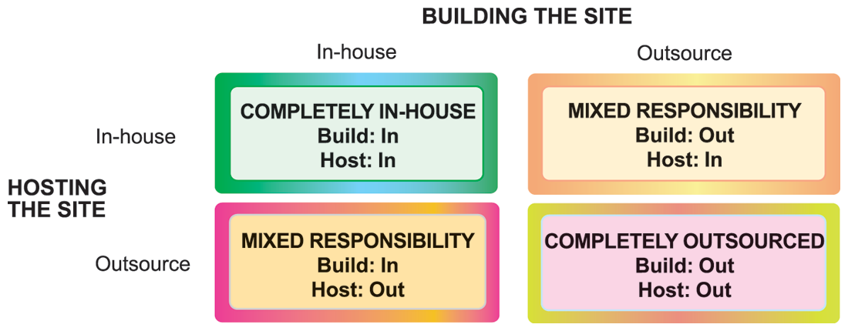
CHAPTER 10: E-COMMERCE: DIGITAL MARKETS, DIGITAL GOODS
The Mobile Digital Platform and Mobile E-commerce
CHOICES IN BUILDING AND HOSTING WEB SITES
FIGURE 10-10
You have a number of alternatives to consider when building and hosting an e-commerce site.
© Pearson Education 2012
Notes:
This graphic illustrates two main decisions in site building: where to host the site and who will build the site. Either task can be outsourced or performed in-house.

Slide 40
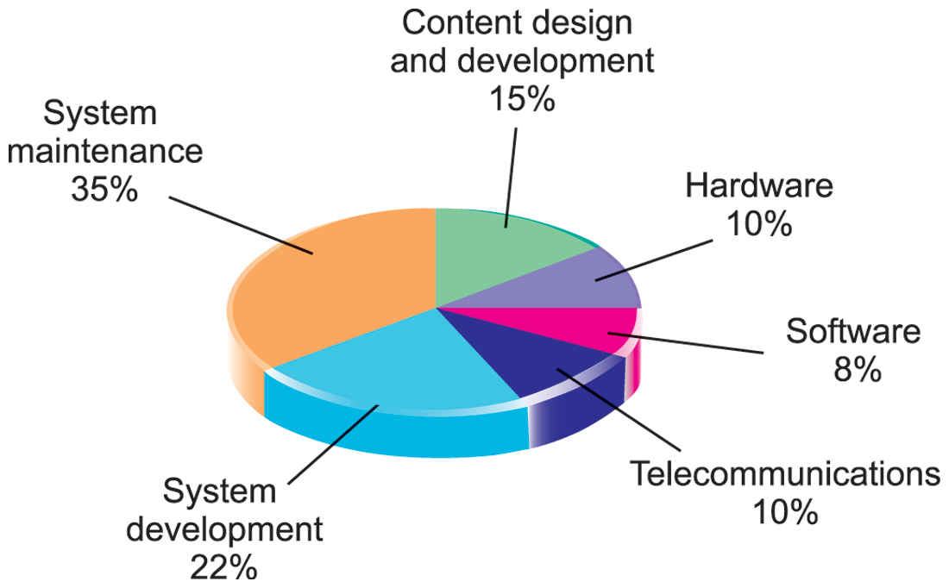
CHAPTER 10: E-COMMERCE: DIGITAL MARKETS, DIGITAL GOODS
The Mobile Digital Platform and Mobile E-commerce
COMPONENTS OF A WEB SITE BUDGET
FIGURE 10-11
© Pearson Education 2012
Notes:
This graphic illustrates the relative size of various Web site cost components. Since 2000, the cost of hardware, software, and telecommunications for building and operating a Web site has fallen dramatically. At the same time, the costs of system maintenance and content creation have risen to make up more than half of typical Web site budgets. Providing content and smooth 24/7 operations are both very labor-intensive.

Slide 41
CHAPTER 10: E-COMMERCE: DIGITAL MARKETS, DIGITAL GOODS
© Pearson Education 2012

